Slide 1

19th November, 2018
Mentor:
Dr Singara Singh
Associate Professor
CSED, TIET
Team Members:
Akshay Sharma | 101683035 | COE 1
Abhishek Sharma | 101503008 | COE 1

Slide 2
Project overview
Pianos are large instruments that need to be carried in a large bag and are prone to damage.
Portable virtual piano that just uses semi-transparent plastic sheet.
Virtual Pianos will be economical and will help young children to get a feel for music and will act as a stepping stone for some of the world’s greatest artists.
Approved Objectives
Assigning the respective tones of piano to the corresponding segments of Virtual Piano made using a semi-transparent plastic sheet.
Real time motion detection of fingers using a camera linked with Raspberry pi.
To play the tone assigned to a segment on detection of finger on that particular segment.

Slide 3
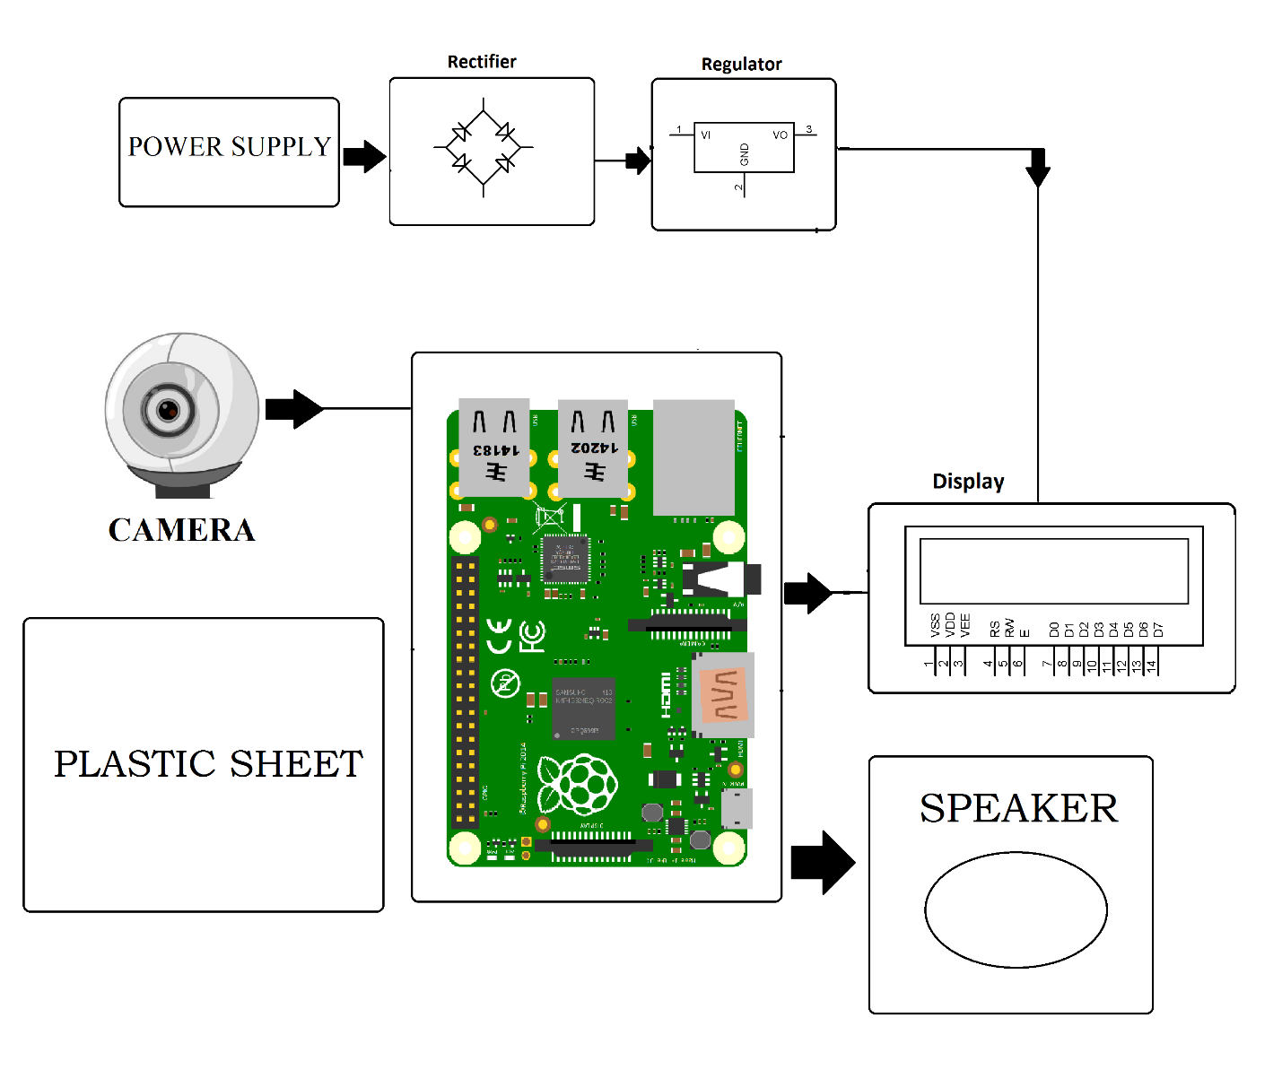
Architecture of the Project

Slide 4
Tools Used
Raspberry Pi - The Raspberry Pi is a low cost, credit-card sized computer that plugs into a computer monitor or TV, and uses a standard keyboard and mouse.
Camera – To capture the real time motion of fingers.
Speaker – To simulate the piano tones.
Transparent Sheet – A virtual keyboard for user to press the segment key.
LCD Display - To display working status of the piano.
The best team is where
the best leader be

Slide 5
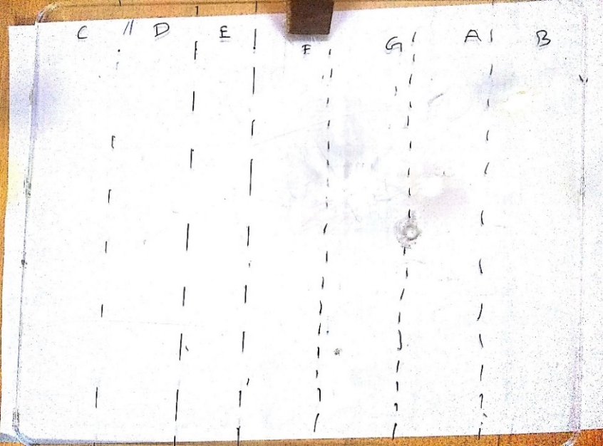
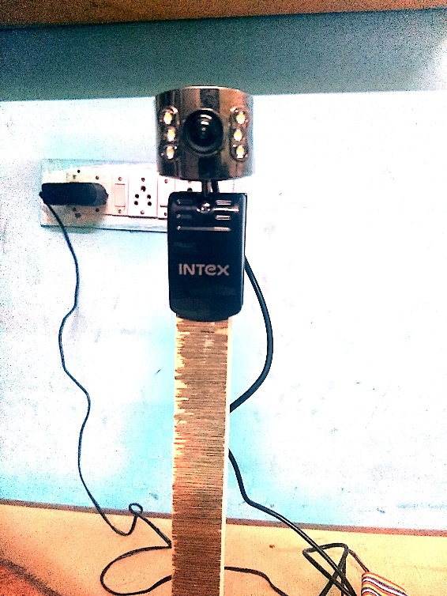
Snapshots of the Project
Semi Transparent Plastic Sheet
Camera attached on wooden mount
The best team is where
the best leader be

Slide 6
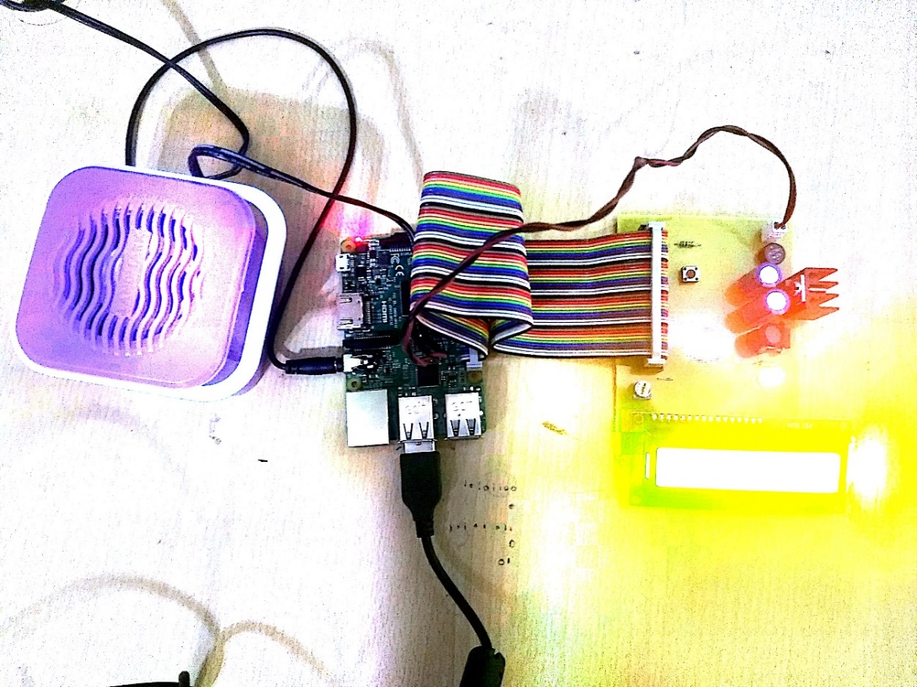
Snapshots of the Project
Speaker, Raspberry pi and LCD Display
The best team is where
the best leader be

Slide 7
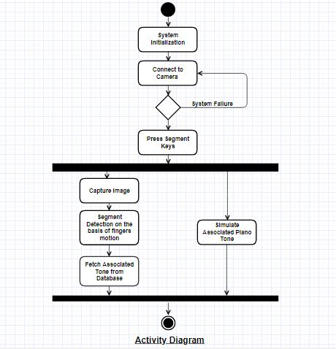
Activity Diagram

Slide 8
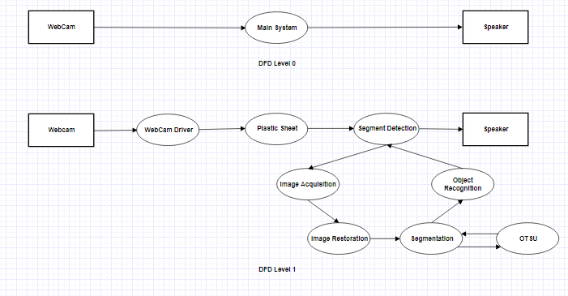
Data Flow Diagram

Slide 9
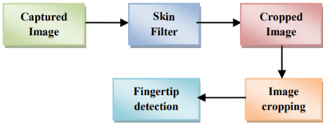
Flowchart for depicting Fingertip detection

Slide 10
Key Highlights of the Project
1.
4.
3.
2.
System Design
Hardware
Assembled
Implemented
Real Time sensing
Simulate piano tones
Created the architecture for our project
Procured & assembled hardware based on system design specification
Finalized the implementation of real time sensing algorithm
Simulate associated piano tone based on the detected segment

Slide 11
Link of the Video
https://www.youtube.com/watch?v=UChkggQru6o

Slide 12
Thank
You

